Slide 1
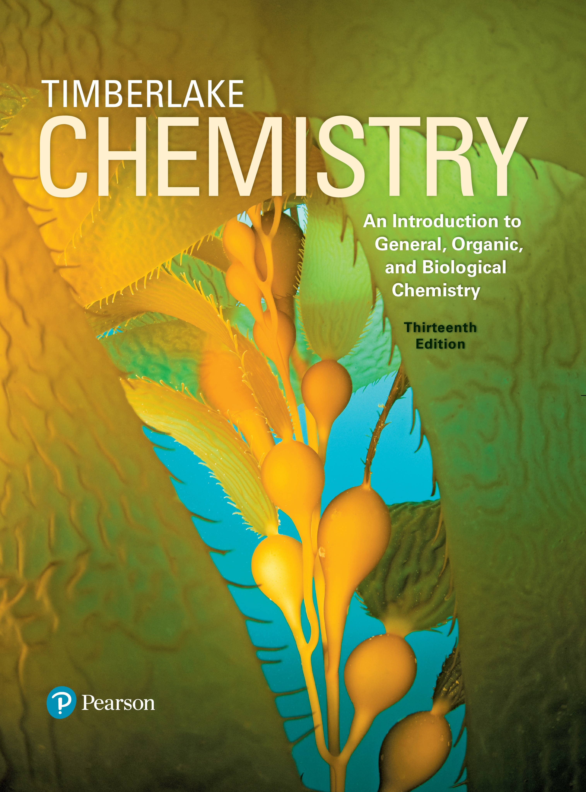
Chemistry: An Introduction to General, Organic, and Biological Chemistry
Thirteenth Edition
Chapter 8
Gases
Copyright © 2018, 2015, 2012 Pearson Education, Inc. All Rights Reserved
Notes:
If this PowerPoint presentation contains mathematical equations, you may need to check that your computer has the following installed:
1) MathType Plugin
2) Math Player (free versions available)
3) NVDA Reader (free versions available)

Slide 2
Gases
Respiratory therapists assess and treat a range of patients. They perform a variety of diagnostic tests including measuring
breathing capacity
concentrations of oxygen and carbon dioxide in a patient’s blood as well as blood p H

Slide 3
8.1 Properties of Gases
We all live at the bottom of the sea of gases called the atmosphere. The gases in the atmosphere include
21% of the atmosphere, is vital to all life processes of
plants and animals
78% of the atmosphere
or ozone, is formed in the upper atmosphere by the
interaction of oxygen with ultraviolet light
Other gases include argon,
(carbon dioxide) and
water vapor
Learning Goal Describe the kinetic molecular theory of gases and the units of measurement used for gases.

Slide 4
Kinetic Molecular Theory
A gas consists of small particles that
move rapidly in straight lines
have essentially no attractive (or repulsive) forces
are very far apart
have very small volumes compared to the volume of the container they occupy
have kinetic energies that increase with an increase in temperature

Slide 5
Properties That Describe a Gas
Gases are described in terms of four properties: pressure (P), volume (V), temperature (T), and amount (n).
Table 8.1 Properties That Describe a Gas
Property | Description | Units of Measurement
Pressure (P) | The force exerted by a gas against the walls of the container | atmosphere (a t m); millimeter of mercury (m m H g); torr (Torr); pascal (P a)
Volume (V) | The space occupied by a gas | liter (L); milliliter (m L)
Temperature (T) | The determining factor of the kinetic energy of gas particles | degree Celsius degrees Celsius kelvin (K) is required in calculations
Amount (n) | The quantity of gas present in a container | gram (g); mole (n) is required in calculations

Slide 6
Volume
The volume of a gas
is the same as the volume of the container it occupies
is usually measured in liters or milliliters
increases with an increase in temperature at a constant pressure

Slide 7
Temperature
The temperature of a gas relates to the average kinetic energy of the molecules and is measured in the Kelvin (K) temperature scale.
When the temperature of a gas is
decreased, the molecules have fewer collisions
increased, the molecules have more collisions

Slide 8
Pressure
Pressure is a measure of the gas particle collisions with sides of a container and is measured in units of
millimeters of mercury (m m H g) or Torr
atmospheres (a t m)
pascals (P a) or kilopascals (k P a)
pounds per square inch (p s i)
Gas particles in the air exert pressure on us. It is called atmospheric pressure.

Slide 9
Barometers Measure Pressure
A barometer
measures the pressure exerted by the gases in the atmosphere
indicates atmospheric pressure as the height in millimeters of the mercury column
760 millimeters H g = 1 a t m = 760 Torr
The barometer was invented by Evangelista Torricelli. At exactly 1 a t m, the barometer tube is exactly 760 millimeters high.
Notes:
The tube is a vacuum with no air particles inside. Gases in the atmosphere at 1 atmosphere exert pressure on the mercury in the dish, causing it to rise in the tube to a height of 760 millimeters of mercury.

Slide 10
Atmospheric Pressure
Atmospheric pressure
is the pressure exerted by a column of air from the top of the atmosphere to the surface of Earth
decreases as altitude increases
is 1 a t m at sea level

Slide 11
Units for Measuring Pressure
Table 8.2 Units for Measuring Pressure
Unit | Abbreviation | Unit Equivalent to 1 atmosphere
atmosphere | a t m | 1 a t m (exact)
millimeters of H g | m m H g | 760 m m H g (exact)
torr | Torr | 760 Torr (exact)
inches of H g | in H g | 29.9 inches H g
pounds per square inch | pounds per square inch (p s i) | 14.7 pounds per square inch
pascal | P a | 101 325 Pascal
kilopascal | k P a | 101.325 kiloPascal

Slide 12
Altitude and Atmospheric Pressure (1 of 2)
Atmospheric pressure changes with variations in weather and altitude.
On a hot, sunny day, the mercury column rises, indicating a higher atmospheric pressure.
On a rainy day, the atmosphere exerts less pressure, which causes the mercury column to fall.

Slide 13
Altitude and Atmospheric Pressure (2 of 2)
Table 8.3 Altitude and Atmospheric Pressure
Location | Altitude (kilometers) | Atmospheric Pressure (millimeters H g)
Dead Sea | negative 0.40 | 800
Sea level | 0.00 | 760
Los Angeles | 0.09 | 752
Las Vegas | 0.70 | 700
Denver | 1.60 | 630
Mount Whitney | 4.50 | 440
Mount Everest | 8.90 | 253

Slide 14
Learning Check 1
What is 475 millimeters H g expressed in atmospheres?
A. 475 atmospheres
B. 0.625 atmospheres
C.
The pressure in a tire is 2.00 atmosphere. What is this pressure in millimeters of mercury?
A. 2.00 millimeters H g
B. 1520 millimeters H g
C. 22 300 millimeters H g

Slide 15
Solution 1
What is 475 millimeters H g expressed in atmospheres?
The answer is B, 0.625 atmospheres.
The pressure in a tire is 2.00 atmosphere. What is this pressure in millimeters of mercury?
The answer is B, 1520 millimeters H g.

Slide 16
Learning Check 2
The downward pressure on the H g in a barometer is Fill in the blank the pressure of the atmosphere.
A. greater than
B. less than
C. the same as
A water barometer is 13.6 times taller than a H g
barometer
because
A.
is less dense than mercury
B.
is heavier than mercury
C. air is more dense than

Slide 17
Solution 2
The downward pressure on the H g in a barometer is Fill in the blank the pressure of the atmosphere.
The answer is C, the same as.
A water barometer is 13.6 times taller than a H g
barometer
because
The answer is A,
is less dense than mercury.

Slide 18
8.2 Pressure and Volume: Boyle’s Law
The inverse relationship between the pressure and volume of a gas is known as Boyle’s law.
Changes occur in opposite directions. When volume increases, the pressure decreases provided the temperature and moles of the gas remain constant.
Learning Goal Use the pressure–volume relationship (Boyle’s law) to calculate the unknown pressure or volume when the temperature and amount of gas do not change.

Slide 19
Boyle’s Law
Boyle’s law states that
the pressure of a gas is inversely related to its volume when T is constant
the product
is constant
when temperature and amount of a gas are held constant
if volume decreases, the
pressure increases

Slide 20
Boyle’s Law: P V = Constant
is a constant, provided that the
temperature and amount of the gas remain the same.
Boyle’s law can be stated as
(T is constant.)

Slide 21
Chemistry Link to Health: Boyle’s Law and Breathing (1 of 2)
During an inhalation,
the lungs expand
the pressure in the lungs decreases
air flows toward the lower pressure in the lungs

Slide 22
Chemistry Link to Health: Boyle’s Law and Breathing (2 of 2)
During an exhalation,
lung volume decreases
pressure within the lungs increases
air flows from the higher pressure in the lungs to the outside

Slide 23
Calculations Using Boyle’s Law (1 of 2)
Freon-12,
was used in refrigeration systems. What is the new
volume of an 8.0-Liters sample of Freon gas initially at 550 millimeters H g after its pressure is changed to 2200 millimeters H g at constant temperature and moles?
SOLUTION:
STEP 1 State the given and needed quantities.
Analyze the Problem | Given | Need | Connect
Analyze the Problem | P sub 1 = 550 millimeters of mercury, V sub 1 = 8.0 liters, P sub 2 = 2200 millimeters of mercury Factors that do not change: T and n | V sub 2 | Boyle’s law P sub 1 V sub 1 = P sub 2 V sub 2 Predict: P increases, V decreases

Slide 24
Calculations Using Boyle’s Law (2 of 2)
STEP 2 Rearrange the gas law equation to solve for the unknown quantity.
Boyle’s law
To solve for
divide both sides by
STEP 3 Substitute values into the gas law equation and calculate.

Slide 25
Learning Check 1
A sample of oxygen gas has a volume of 12.0 Liters at 600 millimeters H g. What is the new pressure when the volume changes to 36.0 Liters at a constant T and n?
A. 200 millimeters H g
B. 400 millimeters H g
C. 1200 millimeters H g

Slide 26
Solution 1 (1 of 3)
A sample of oxygen gas has a volume of 12.0 Liters at 600 millimeters H g. What is the new pressure when the volume changes to 36.0 Liters at a constant T and n?
STEP 1 State the given and needed quantities.
Analyze the Problem | Given | Need | Connect
Analyze the Problem | P sub 1 = 600 millimeters of mercury, V sub 1 = 12.0 liters, V sub 2 = 36.0 liters Factors that do not change: T and n | P sub 2 | Boyle’s law P sub 1 V sub 1 = P sub 2 V sub 2 Predict: V increases, P decreases

Slide 27
Solution 1 (2 of 3)
A sample of oxygen gas has a volume of 12.0 Liters at 600 millimeters H g. What is the new pressure when the volume changes to 36.0 Liters at a constant T and n?
STEP 2 Rearrange the gas law equation to solve for the unknown quantity.

Slide 28
Solution 1 (3 of 3)
A sample of oxygen gas has a volume of 12.0 Liters at 600 millimeters H g. What is the new pressure when the volume changes to 36.0 Liters at a constant T and n?
STEP 3 Substitute values into the gas law equation and calculate.
The answer is A, 200 millimeters H g.

Slide 29
Learning Check 2
For a cylinder containing helium gas, indicate whether cylinder A or cylinder B represents the new volume for the following changes. (n and T are constant.)
pressure decreases
pressure increases

Slide 30
Solution 2
For a cylinder containing helium gas, indicate whether cylinder A or cylinder B represents the new volume for the following changes. (n and T are constant.)
pressure decreases
cylinder B
pressure increases
cylinder A

Slide 31
Learning Check 3
If a sample of helium gas has a volume of 120 milliLiters and a pressure of 850 millimeters H g, what is the new volume if the pressure is changed to 425 millimeters H g at a constant T and n?
A. 60 milliLiters
B. 120 milliLiters
C. 240 milliLiters

Slide 32
Solution 3 (1 of 2)
If a sample of helium gas has a volume of 120 milliLiters and a pressure of 850 millimeters H g, what is the new volume if the pressure is changed to 425 millimeters H g at a constant T and n?
STEP 1 State the given and needed quantities.
Analyze the Problem | Given | Need | Connect
Analyze the Problem | P sub 1 = 850 millimeters of mercury, V sub 1 = 120 milliliters, P sub 2 = 425 millimeters of mercury Factors that do not change: T and n | V sub 2 | Boyle’s law P sub 1 V sub 1 = P sub 2 V sub 2 Predict: P increases, V decreases

Slide 33
Solution 3 (2 of 2)
If a sample of helium gas has a volume of 120 milliLiters and a pressure of 850 millimeters H g, what is the new volume if the pressure is changed to 425 millimeters H g at a constant T and n?
STEP 2 Rearrange the gas law equation to solve for the unknown quantity.
STEP 3 Substitute values into the gas law equation and calculate.
The answer is C.

Slide 34
Learning Check 4
A sample of helium gas in a balloon has a volume of 6.4 Liters at a pressure of 0.70 atmospheres. At 1.40 atmospheres (T and n are constant), is the new volume represented by A, B, or C?

Slide 35
Solution 4
A sample of helium gas in a balloon has a volume of 6.4 Liters at a pressure of 0.70 atmospheres. At 1.40 atmospheres (T and n are constant), is the new volume represented by A, B, or C?
At a higher pressure (T and n constant), the new volume is represented by the smallest balloon, A.

Slide 36
8.3 Temperature and Volume: Charles’s Law
If we increase the temperature of a gas sample, kinetic molecular theory states that the motion (kinetic energy) of the gas particles will also increase.
If the amount and pressure of the gas is held constant, the volume of the container will increase.
Learning Goal Use the temperature–volume relationship (Charles’s law) to calculate the unknown temperature or volume when the pressure and amount of gas do not change.

Slide 37
Charles’s Law
In Charles’s law,
the Kelvin temperature of a gas is directly related to the volume
pressure and moles of gas are constant
when the temperature of a sample of gas increases, its volume increases at a constant pressure
Notes:
T 1 = 200 Kelvins and V 1 = 1 liter. When the temperature increases to 400 Kelvins, volume increases and the piston rises, but pressure remains constant. T 2 = 400 Kelvins and V 2 = 2 liter.

Slide 38
Charles’s Law: V and T
For two conditions, Charles’s law is written
Rearranging Charles’s law to solve for
we obtain the
following:

Slide 39
Learning Check 1
Solve Charles’s law expression for

Slide 40
Solution 1
Solve Charles’s law expression for
Cross-multiply to give the following:
Isolate
by dividing through by

Slide 41
Calculations Using Charles’s Law (1 of 2)
A balloon has a volume of 785 mL at
If the
If the temperature drops to
what is the new volume of
the balloon at constant pressure and moles?
SOLUTION:
STEP 1 State the given and needed quantities.
Analyze the Problem | Given | Need | Connect
Analyze the Problem | T sub 1 = 294 kelvin, V sub 1 = 785 milliliters, T sub 2 = 273 kelvin Factors that do not change: P and n |  | Charles’s law V sub 1 over T sub 1 = V sub 2 over T sub 2. V sub 1 over T sub 1 = V sub 2 over T sub 2. Predict: T decreases, V decreases

Slide 42
Calculations Using Charles’s Law (2 of 2)
A balloon has a volume of 785 mL at
If the
If the temperature drops to
what is the new volume of
the balloon at constant pressure and moles?
STEP 2 Rearrange to solve for unknown quantity,
STEP 3 Substitute values into the gas law equation and calculate.

Slide 43
Learning Check 2
A sample of oxygen gas has a volume of 420 m L at a
temperature of
At what temperature (in degrees
Celsius) will the volume of the oxygen be 640 m L? (P and n are constant.)
A.
B.
C.

Slide 44
Solution 2 (1 of 2)
A sample of oxygen gas has a volume of 420 m L at a
temperature of
At what temperature (in degrees
Celsius) will the volume of the oxygen be 640 m L? (P and n are constant.)
STEP 1 State the given an needed quantities.
Analyze the Problem | Given | Need | Connect
Analyze the Problem | T sub 1 = 291 kelvin, V sub 1 = 420 milliliters, V sub 2 = 640 milliliters Factors that do not change: P and n | T sub 2. | Charles’s law V sub 1 over T sub 1 = V sub 2 over T sub 2. Predict: V increases, T increases

Slide 45
Solution 2 (2 of 2)
A sample of oxygen gas has a volume of 420 m L at a temperature
of
At what temperature (in degrees Celsius) will the
volume of the oxygen be 640 m L? (P and n are constant.)
STEP 2 Rearrange to solve for unknown quantity,
STEP 3 Substitute values into the gas law equation and calculate.
The answer is B.

Slide 46
Learning Check 3
Use the gas laws to complete each sentence with increases or decreases.
A. Pressure Fill in the blank when V decreases at constant temperature and moles.
B. When T decreases, V Fill in the blank at constant pressure and moles.
C. Pressure Fill in the blank when V changes from 12 L to 24 L at constant temperature and moles.
D. Volume Fill in the blank when T changes from
at constant pressure and moles.

Slide 47
Solution 3
Use the gas laws to complete each sentence with increases or decreases.
A. Pressure increases when V decreases at constant temperature and moles.
B. When T decreases, V decreases at constant pressure and moles.
C. Pressure decreases when V changes from 12 L to 24 L at constant temperature and moles.
D. Volume increases when T changes from
at constant pressure and moles.

Slide 48
8.4 Temperature and Pressure: Gay-Lussac’s Law
Gay-Lussac’s law: when the Kelvin temperature of a gas is doubled and the volume and amount of gas do not change, the pressure also doubles.
Learning Goal Use the temperature–pressure relationship (Gay-Lussac’s law) to calculate the unknown temperature or pressure when the volume and amount of gas do not change.
Notes:
T 1 = 200 Kelvins and P 1 = 1 atmosphere. When the temperature increases to 400 Kelvins, pressure increases to increases to 2 atmospheres. The level of the piston does not change. T 2 = 400 Kelvins and P 2 = 2 atmospheres.

Slide 49
Gay-Lussac’s Law
In Gay-Lussac’s law,
the pressure exerted by a gas is directly related to the Kelvin temperature of the gas
volume and amount of gas are constant
Notes:
T 1 = 200 Kelvins and P 1 = 1 atmosphere. When the temperature increases to 400 Kelvins, pressure increases to increases to 2 atmospheres. The level of the piston does not change. T 2 = 400 Kelvins and P 2 = 2 atmospheres.

Slide 50
Learning Check 1
Solve Gay-Lussac’s law for

Slide 51
Solution 1
Solve Gay-Lussac’s law for
Multiply both sides by
and cancel:

Slide 52
Calculations Using Gay-Lussac’s Law (1 of 2)
A gas has a pressure at 2.0 a t m at
What is the new
pressure when the temperature is
(Volume and moles
remain constant.)
SOLUTION:
STEP 1 State the given and needed quantities.
Analyze the Problem | Given | Need | Connect
Analyze the Problem | P sub 1 = 2.0 atmospheres, T sub 1 = 291 kelvin, T sub 2 = 335 kelvin Factors that do not change: V and n | P sub 2 | Gay-Lussac’s law P sub 1 over T sub 1 = P sub 2 over T sub 2. Predict: T increases, P increases

Slide 53
Calculations Using Gay-Lussac’s Law (2 of 2)
A gas has a pressure at 2.0 a t m at
What is the new
pressure when the temperature is
(Volume and moles
remain constant.)
STEP 2 Rearrange to solve for unknown quantity,
Solve Gay-Lussac’s law for
STEP 3 Substitute values into the gas law equation and calculate.

Slide 54
Learning Check 2
A gas has a pressure of 645 Torr at
What is the
temperature in degrees Celsius if the pressure increases to 824 Torr? (V and n remain constant.)

Slide 55
Solution 2 (1 of 2)
A gas has a pressure of 645 Torr at
What is the
temperature in degrees Celsius if the pressure increases to 824 Torr? (V and n remain constant.)
STEP 1 State the given and needed quantities.
Analyze the Problem | Given | Need | Connect
Analyze the Problem | P sub 1 = 645 Torr, T sub 1 = 401 kelvin, P sub 2 = 824 Torr Factors that do not change: V and n | T sub 2 | Gay-Lussac’s law P sub 1 over T sub 1 = P sub 2 over T sub 2. Predict: P increases, T increases

Slide 56
Solution 2 (2 of 2)
A gas has a pressure of 645 Torr at
What is the
temperature in degrees Celsius if the pressure increases to 824 Torr? (V and n remain constant.)
STEP 2 Rearrange to solve for unknown quantity,
Solve Gay-Lussac’s law for
STEP 3 Substitute values into the gas law equation and calculate.

Slide 57
Learning Check 3
Explain why water boils at a lower temperature in the mountains than at sea level.

Slide 58
Solution 3
Explain why water boils at a lower temperature in the mountains than at sea level.
Atmospheric pressure in the mountains is less than at sea level. The vapor pressure of the water reaches the atmospheric pressure at a lower temperature.

Slide 59
8.5 The Combined Gas Law
Under water, the pressure on a diver is greater than the atmospheric pressure.
The combined gas law comes from the pressure–volume–temperature relationships for gases that we have studied.
Learning Goal Use the combined gas law to calculate the unknown pressure, volume, or temperature of a gas when changes in two of these properties are given and the amount of gas does not change.

Slide 60
The Combined Gas Law
The combined gas law uses the pressure–volume temperature relationships from Boyle’s law, Charles’s law, and Gay-Lussac’s law where n is constant.
Notes:
Boyle's law, P sub 1 times V sub 1 = P sub 2 times V sub 2. Charles' law, start fraction V sub 1 over T sub 1 end fraction = start fraction V sub 2 over T sub 2 end fraction. Gay Lussac's law, start fraction P sub 1 over T sub 1 end fraction = start fraction P sub 2 over T sub 2 end fraction. These three equations are together labeled, combined gas law and is given by the equation, start fraction P sub 1 times V sub 1 over T sub 1 end fraction = start fraction P sub 2 times V sub 2 over T sub 2 end fraction.

Slide 61
Summary of Gas Laws
Table 8.4 Summary of Gas Laws
Combined Gas Law | Properties That Do Not Change | Relationship | Name of Gas Law
Start fraction, P 1 times V 1, over T 1, end fraction = start fraction, P 2 times V 2, over T 2, end fraction. Both T values are crossed out. | T, n | P sub 1 times V sub 1 = P sub 2 times V sub 2. | Boyle’s law
Start fraction, P 1 times V 1, over T 1, end fraction = start fraction, P 2 times V 2, over T 2, end fraction. Both P values are crossed out. | P, n | Start fraction, V 1 over T 1, end fraction = Start fraction, V 2 over T 2, end fraction. | Charles’s law
Start fraction, P 1 times V 1, over T 1, end fraction = start fraction, P 2 times V 2, over T 2, end fraction. Both V values are crossed out. | V, n | Start fraction, P 1 over T 1, end fraction = Start fraction, P 2 over T 2, end fraction. | Gay-Lussac’s law

Slide 62
Calculations Using Combined Gas Law (1 of 2)
A gas has a volume of 675 m L at
and 646 millimeters H g
pressure. What is the volume (in milliliters) of the gas at
and a pressure of 802 millimeters H g? (n is constant.)
Solution:
Step 1 State the given and needed quantities.
Analyze the Problem | Given | Need | Connect
Analyze the Problem | P sub 1 = 646 millimeters of mercury T sub 1 = 308 kelvin, V sub 1 = 675 milliliters P sub 2 = 802 millimeters of mercury, T sub 2 = 178 kelvin Factors that do not change: n | T sub 2 | combined gas law P sub 1 V sub 1 over T sub 1 = P sub 2 V sub 2 over T sub 2

Slide 63
Calculations Using Combined Gas Law (2 of 2)
A gas has a volume of 675 m L at
and 646 millimeters H g
pressure. What is the volume (in milliliters) of the gas at
and a pressure of 802 millimeters H g? (n is constant.)
Step 2 Rearrange to solve for unknown quantity,
Step 3 Substitute values into the gas law equation and calculate.
Notes:
Start fraction P sub 1 V sub 1 over T sub 1 end fraction = start fraction P sub 2 V sub 2 over T sub 2 end fraction. Second. V sub 2 = V sub 1 times start fraction P sub 1 over P sub 2 end fraction times start fraction T sub 2 over T sub 1 end fraction.

Slide 64
Learning Check 1
A sample of helium gas has a volume of 0.180 L, a pressure
of 0.800 atmospheres, and a temperature of
At what
temperature (in degrees Celsius) will the helium have a volume of 90.0 m L and a pressure of 3.20 a t m? (n remains constant.)

Slide 65
Solution 1 (1 of 3)
A sample of helium gas has a volume of 0.180 L, a pressure
of 0.800 atmospheres, and a temperature of
At what
temperature (in degrees Celsius) will the helium have a volume of 90.0 m L and a pressure of 3.20 a t m? (n remains constant.)
Step 1 State the given and needed quantities.
Analyze the Problem | Given | Need | Connect
Analyze the Problem | P sub 1 = 0.800 atmospheres T sub 1 = 302 kelvin, V sub 1 = 0.180 liters, 180 milliliters P sub 1 = 3.20 atmospheres, V sub 2 = 90.0 milliliters Factors that do not change: n | T sub 2 | combined gas law P sub 1 V sub 1 over T sub 1 = P sub 2 V sub 2 over T sub 2.

Slide 66
Solution 1 (2 of 3)
A sample of helium gas has a volume of 0.180 L, a pressure
of 0.800 atmospheres, and a temperature of
At what
temperature (in degrees Celsius) will the helium have a volume of 90.0 m L and a pressure of 3.20 a t m? (n remains constant.)
Step 2 Rearrange to solve for unknown quantity,
Notes:
Start fraction P sub 1 V sub 1 over T sub 1 end fraction = start fraction P sub 2 V sub 2 over T sub 2 end fraction. Second. T sub 2 = T sub 1 times start fraction P sub 2 over P sub 1 end fraction times start fraction V sub 2 over V sub 1 end fraction.

Slide 67
Solution 1 (3 of 3)
A sample of helium gas has a volume of 0.180 L, a pressure
of 0.800 atmospheres, and a temperature of
At what
temperature (in degrees Celsius) will the helium have a volume of 90.0 m L and a pressure of 3.20 a t m? (n remains constant.)
Step 3 Substitute the values into the gas law equation and calculate.
Notes:
Start fraction P sub 1 V sub 1 over T sub 1 end fraction = start fraction P sub 2 V sub 2 over T sub 2 end fraction. Second. T sub 2 = T sub 1 times start fraction P sub 2 over P sub 1 end fraction times start fraction V sub 2 over V sub 1 end fraction.

Slide 68
8.6 Volume and Moles: Avogadro’s Law
The molar volume of a gas at S T P is about the same as the volume of three basketballs.
The volume of 1 mole of gas is 22.4 liters.
Learning Goal Use Avogadro’s law to calculate the unknown amount or volume of a gas when the pressure and temperature do not change.

Slide 69
Avogadro’s Law: Volume and Moles
In Avogadro’s law,
the volume of a gas is directly related to the number of moles (n) of gas
T and P are constant
Notes:
n 1 = 1 mole and V 1 = 1 liter. When the moles of gas increase to 2 moles, the volume increases to 2 liters and the piston rises. Pressure remains the same. n 2 = 2 moles and V 2 = 2 liters.

Slide 70
Calculations Using Avogadro’s Law (1 of 3)
If 0.75 mole of helium gas occupies a volume of 1.5 Liters, what volume (in liters) will 1.2 moles of helium occupy at the same temperature and pressure?
A. 0.94 Liters
B. 1.8 Liters
C. 2.4 Liters

Slide 71
Calculations Using Avogadro’s Law (2 of 3)
If 0.75 mole of helium gas occupies a volume of 1.5 Liters, what volume (in liters) will 1.2 moles of helium occupy at the same temperature and pressure?
Solution:
Step 1 State the given and needed quantities.
Analyze the Problem | Given | Need | Connect
Analyze the Problem | V sub 1 = 1.5 liters, n sub 1 = 0.75 moles n sub 2 = 1.2 moles Factors that do not change: P and T | V sub 2 | Avogadro’s law V sub 1 over n sub 1 = V sub 2 over n sub 2. Predict: n increases, V increases

Slide 72
Calculations Using Avogadro’s Law (3 of 3)
If 0.75 mole of helium gas occupies a volume of 1.5 Liters, what volume (in liters) will 1.2 moles of helium occupy at the same temperature and pressure?
Step 2 Rearrange to solve for unknown quantity,
Step 3 Substitute values into the gas law equation and calculate.
The answer is C.

Slide 73
Standard Temperature and Pressure
The volumes of gases can be compared at S T P, Standard Temperature and Pressure, when they have
the same temperature
standard temperature (T)
the same pressure
standard pressure (P)
1 atmosphere (760 millimeters H g)

Slide 74
Molar Volume, S T P
At standard temperature and pressure (S T P), 1 mole of a gas occupies a volume of 22.4 Liters, which is called its molar volume.
Use this equality as a conversion factor for gas at S T P:
22.4 Liters = 1 mole gas

Slide 75
Molar Volume
Notes:
• First balloon. 1 mole of H e, 4.003 grams of H e, 273 Kelvins, 1 atmosphere.
• Second balloon. 1 mole of O 2, 32.00 grams of O 2, 273 Kelvins, 1 atmosphere.
• Third balloon. 1 mole of N 2, 28.02 grams of N 2, 273 Kelvins, 1 atmosphere.

Slide 76
Calculations Using Molar Volume (1 of 2)
What is the volume occupied by 2.75 moles of
gas at S T P?
Solution:
Step 1 State the given and needed quantities.
Analyze the Problem | Given | Need | Connect
Analyze the Problem | 2.75 moles of N sub 2 at S T P | volume of N sub 2 gas at S T P | molar volume (S T P)
Step 2 Write a plan to calculate the needed quantity.

Slide 77
Calculations Using Molar Volume (2 of 2)
What is the volume occupied by 2.75 moles of
gas at S T P?
Step 3 Write equalities and conversion factors including 22.4 L /mole at S T P.
At S T P, 22.4 L = 1 mole
Step 4 Set up the problem with factors to cancel units.

Slide 78
Learning Check 1
What is the volume at S T P of 4.00 grams of
A. 5.60 Liters
B. 11.2 Liters
C. 44.8 Liters
How many grams of H e are present in 8.00 Liters of gas at S T P?
A. 25.6 grams
B. 0.357 grams
C. 1.43 grams

Slide 79
Solution 1 (1 of 5)
STEP 1 State given and needed quantities.
What is the volume at S T P of 4.00 grams of
Analyze the Problem | Given | Need | Connect
Analyze the Problem | 4.00 grams C H sub 4, gaseous at S T P | volume C H sub 4, gaseous at S T P | molar mass, molar volume (S T P)
How many grams of H e are present in 8.00 L of gas at S T P?
Analyze the Problem | Given | Need | Connect
Analyze the Problem | 8.00 L H e, gaseous at S T P | grams of H e, gaseous at S T P | molar mass, molar volume (S T P)

Slide 80
Solution 1 (2 of 5)
STEP 2 Write a plan to calculate the needed quantity.
What is the volume at S T P of 4.00 grams of
How many grams of H e are present in 8.00 L of gas at S T P?

Slide 81
Solution 1 (3 of 5)
Step 3 Write equalities and conversion factors including 22.4 Liters/mole at S T P.
What is the volume at S T P of 4.00 grams of
22.4 Liters = 1 mole of
1 mole of C H ₄ = 16.05 gra

Slide 82
Solution 1 (4 of 5)
Step 3 Write equalities and conversion factors including 22.4 Liters/mole at S T P.
How many grams of H e are present in 8.00 Liters of gas at S T P?
1 mole of H e = 4.00 g H e
22.4 Liters = 1 mole of H e

Slide 83
Solution 1 (5 of 5)
Step 4 Set up the problem with factors to cancel units.
What is the volume at S T P of 4.00 grams of
The answer is A, 5.60 Liters.
How many grams of H e are present in 8.00 Liters of gas at S T P?
The answer is C, 1.43 grams.

Slide 84
8.7 Partial Pressure: Dalton’s Law
Many gas samples are a mixture of gases. For example, the air you breathe is a mixture of mostly oxygen and nitrogen gases.
Table 8.5 Typical Composition of Air
Learning Goal Use Dalton’s law of partial pressures to calculate the total pressure of a mixture of gases.
Notes:
Gas Partial pressure, millimeters of mercury Percentage
Nitrogen, N 2 594 78.2
Oxygen, O 2 160 21.0
Carbon dioxide, C O 2. Argon, A r. Water vapor, H 2 O. 6 0.8
Total air 760 100

Slide 85
Partial Pressure
The partial pressure of a gas is the pressure that each gas in a mixture would exert if it were by itself in the container.
Notes:
A second tank contains argon gas at P = 4.0 atmospheres. The gases in these two tanks are combined into one tank. The pressure is calculated as follows. P total = P sub H e + P sub A r = 2.0 atmospheres + 4.0 atmospheres = 6.0 atmospheres.

Slide 86
Dalton’s Law of Partial Pressures
Dalton’s law of partial pressures indicates that
pressure depends on the total number of gas particles, not on the types of particles
the total pressure exerted by gases in a mixture is the sum of the partial pressures of those gases

Slide 87
Total Pressure
For example, at S T P, 1 mole of a pure gas in a volume of 22.4 Liters will exert the same pressure as 1 mole of a gas mixture in 22.4 Liters.

Slide 88
Air Is a Mixture of Gases
The air we breathe
is a mixture of different gases
Table 8.5 Typical Composition of Air
contains mostly
and
and small amounts
of other gases
What we call the atmospheric pressure is actually the sum of the partial pressures of the gases in the air.
Notes:
Gas Partial pressure, millimeters of mercury Percentage
Nitrogen, N 2 594 78.2
Oxygen, O 2 160 21.0
Carbon dioxide, C O 2. Argon, A r. Water vapor, H 2 O. 6 0.8
Total air 760 100

Slide 89
Solving for Partial Pressure (1 of 3)
A scuba tank contains
with a pressure of 0.450 atm and H e at
855 millimeters H g. What is the total pressure, in millimeters of mercury, in the tank? (Volume and temperature are constant.)
Solution:
Analyze the Problem | Given | Need | Connect
Analyze the Problem | P sub O sub 2 = 0.450 atmospheres P sub H e = 855 millimeters of mercury | P sub total | Dalton’s law
Step 1 Write the equation for the sum of the partial pressures.

Slide 90
Solving for Partial Pressure (2 of 3)
A scuba tank contains
with a pressure of 0.450 atm and H e at
855 millimeters H g. What is the total pressure, in millimeters of mercury, in the tank? (Volume and temperature are constant.)
Step 2 Rearrange the equation to solve for the unknown pressure. Convert units to match.

Slide 91
Solving for Partial Pressure (3 of 3)
A scuba tank contains
with a pressure of 0.450 atm and H e at
855 millimeters H g. What is the total pressure, in millimeters of mercury, in the tank? (Volume and temperature are constant.)
Step 3 Substitute known pressures and calculate the unknown partial pressure.

Slide 92
Learning Check 1
For a deep dive, a scuba diver uses a mixture of helium and oxygen with a pressure of 8.00 atmospheres. If the oxygen has a partial pressure of 1280 millimeters H g, what is the partial pressure of the helium? (Volume and temperature are constant.)
A. 520 millimeters H g
B. 2040 millimeters H g
C. 4800 millimeters H g

Slide 93
Solution 1 (1 of 3)
For a deep dive, a scuba diver uses a mixture of helium and oxygen with a pressure of 8.00 atmospheres. If the oxygen has a partial pressure of 1280 millimeters H g, what is the partial pressure of the helium? (Volume and temperature are constant.)
Analyze the Problem | Given | Need | Connect
Analyze the Problem | P sub total = 8.00 atmospheres P sub O sub 2 = 1280 millimeters of mercury | P sub H e | Dalton’s law
Step 1 Write the equation for the sum of the partial pressure

Slide 94
Solution 1 (2 of 3)
For a deep dive, a scuba diver uses a mixture of helium and oxygen with a pressure of 8.00 atmospheres. If the oxygen has a partial pressure of 1280 millimeters H g, what is the partial pressure of the helium? (Volume and temperature are constant.)
Step 2 Rearrange the equation to solve for the unknown pressure. Convert units to match.

Slide 95
Solution 1 (3 of 3)
For a deep dive, a scuba diver uses a mixture of helium and oxygen with a pressure of 8.00 atmospheres. If the oxygen has a partial pressure of 1280 millimeters H g, what is the partial pressure of the helium? (Volume and temperature are constant.)
Step 3 Substitute known pressures and calculate the unknown partial pressure.
The answer is C, 4800 millimeters H g.

Slide 96
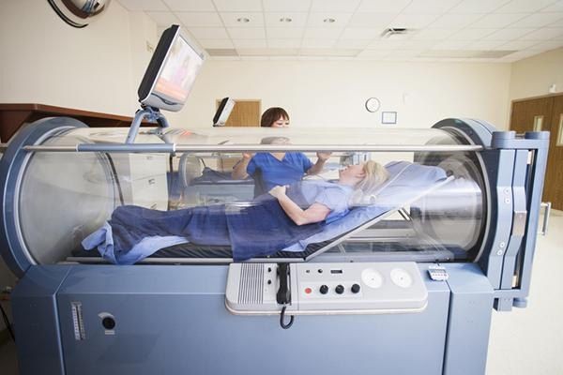
Hyperbaric Chambers (2 to 3 Atm)

Slide 97
Uses of Hyperbaric Therapy
Burn patients may undergo treatment for burns and infections.
A greater oxygen pressure increases the level of dissolved oxygen in the blood and tissues, where it fights bacterial infections. High levels of oxygen are toxic to many strains of bacteria.
The hyperbaric chamber may also be used during surgery, to help counteract carbon monoxide (CO) poisoning
and to treat some cancers.

Slide 98
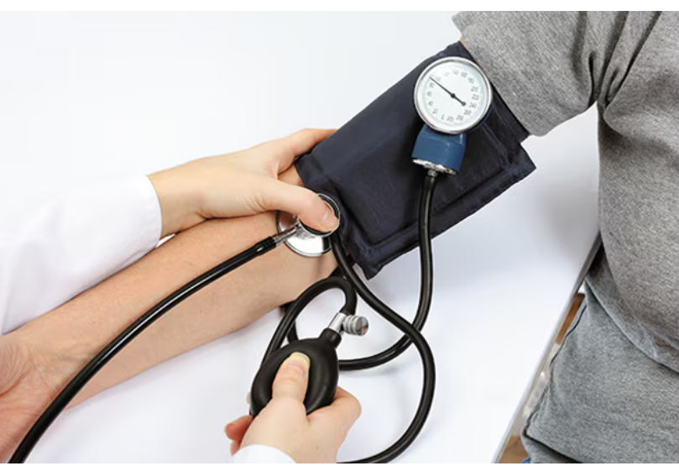
Blood Pressure (120/80 mmHg ideal)

Slide 99
Concept Map
Notes:
● Gases are described by the kinetic molecular theory of gases which states that gas particles are far apart, move fast, and exert pressure.
● Gases behave according to gas laws that relate the following values and laws. P and V, Boyle’s law. V and T, Charles’s law. P and T, Gay Lussac’s law. And P, V and T, the combined gas law.
Gas volume and moles are related by V and n, Avogadro’s law. At S T P, this law gives molar volume, for a gas or a gas mixture where gases exert partial pressures. Molar volume is used to find moles or volume of gases.

